Slide 1
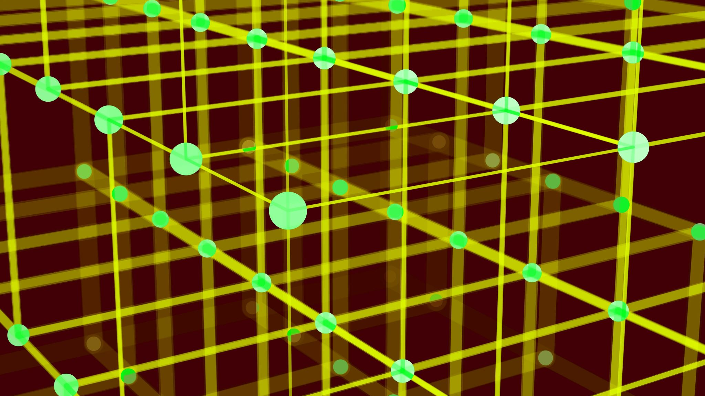
Kmeans & Hierarchical Clustering
Machine Learning
SB2
Mario GONZÁLEZ & Lale ASALIOGLU
02.12.2022

Slide 2
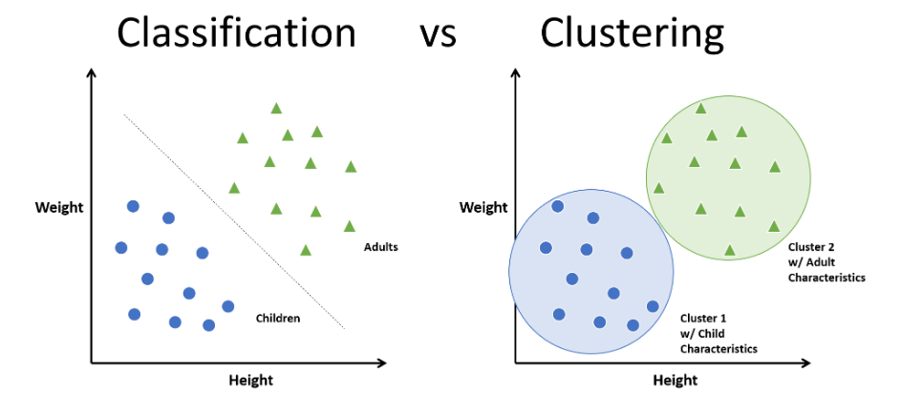
What is Clustering?
Clustering refers to the process of generating labeled groups of data based on how similar they are. Clustering is similar to Classification, but not quite the same…
Characteristics
Clustering is a method of
UNSUPERVISED LEARNING
So, it has no target or ground truth
to estimate.
Does not have a specific label order
Can group the data
through different methods:
K-means
K-nearest neighbors
Hierarchical clustering

Slide 3
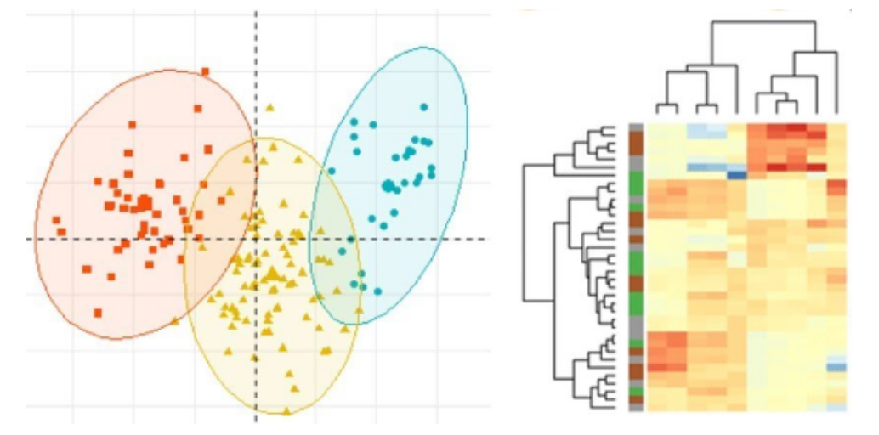
Why do we cluster?
Given a collection of data objects, we want to form groups of data that is similar and dissimilar from other data. When we make these groups, we do not really care how our data is presented as long as it is grouped.
A typical cluster contains as a result:
Data observations similar to one another within the cluster
Data observations dissimilar to
objects in other clusters
Types of clustering
In this presentation we will focus on two types of clustering:
K-means clustering: measures the distance from a data point to a centroid.
Hierarchical clustering:
measures the similarity between
pairs of points and forms clusters
from it.

Slide 4
K-means clustering
What is it?
An algorithm that groups the data based on its euclidean distance in a certain dimension against a centroid. The data will be separated in K clusters (arbitrary) and calculate the distance of the data to the centroid.
How does it work?
K-means clustering method works based on the following steps
The computer has K centroids in determined locations in the data spectrum.
The computer computes the distance between the data points and the centroids.
The computer labels the points that are the nearest to each centroid.
The computer moves the centroid to the mean point of the labeled data.

Slide 5
K-means clustering: Advantages and Disadvantages
Advantages
Disadvantages
The K-means method presents the following advantages:
Some of the disadvantages of this method are:
It is one of the fastest clustering methods.
It is relatively simple and technologically cheap.
Will always converge.
Can easily cluster big amounts of data.
It does not matter where the centroids start.
Can generalize itself to clusters with different shapes and size.
K is arbitrary.
It is highly dependant on initial conditions.
Has dificulty grouping data of clusters with different shape and size.
Outlier values can drag the clusters.
Escalates badly with a high number of dimensions.

Slide 6
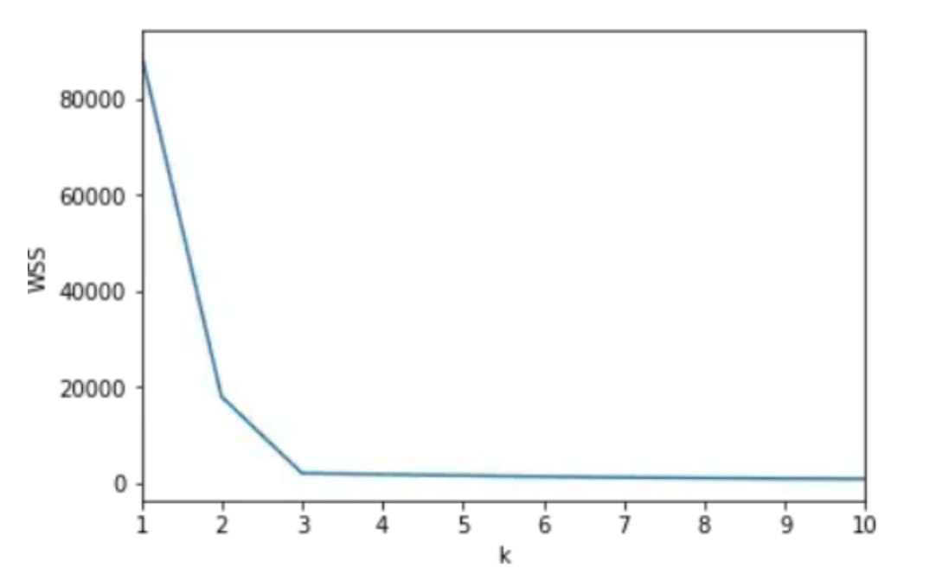
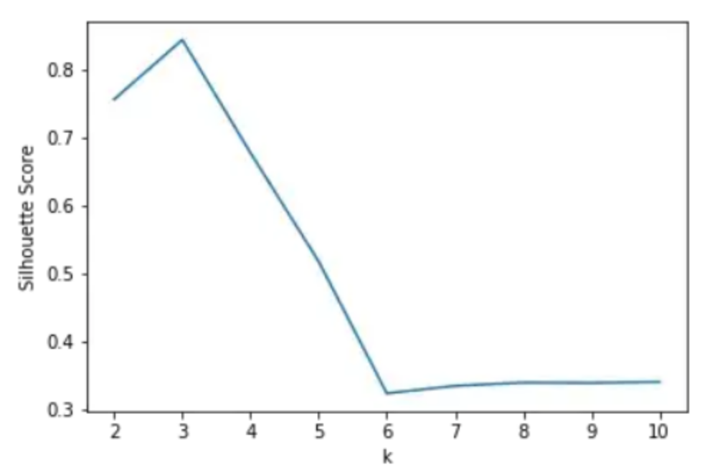
What about K?
One of the problems is that K is arbitrary and we have to decide it ourselves. There is an amount of methods to retrieve it, and choose the optimal K.
The elbow method
The silhouette method
The calculation of the Within-Cluster-Sum of Squared Errors (WSS) for different values of K and choose the K for which the WSS starts to diminish. If you plot the WSS against K, it will look as an elbow. We look for the elbow point of the graph, where the k is optimal.
The silhouette value measures how a point is similar to its own centroid. Valued between (-1, +1), with one being the most similar to the centroid, and -1 being the least similar to the centroid. We look for the maximum value of the silhouette.

Slide 7
Hierarchical Clustering
Hierarchical clustering is a clustering method focused on the grouping of data points based on the similarity between one another. This in turn generates super-clusters of the initial clusters. This method has two categories
Agglomerative
Divisive
Known as the bottom-up approach: Each observation starts as its own cluster, and pairs of clusters are formed while we move up the hierarchy.
Known as the top-down approach: Is the reverse of the agglomerative method. Starts with a single cluster containing all objects and then splits the cluster into two least similar clusters based on their characteristics.

Slide 8
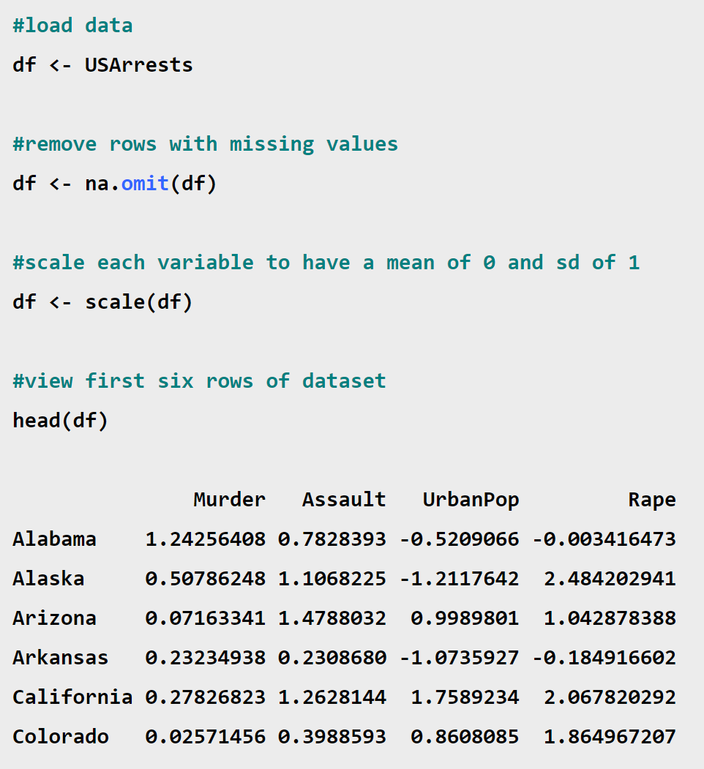
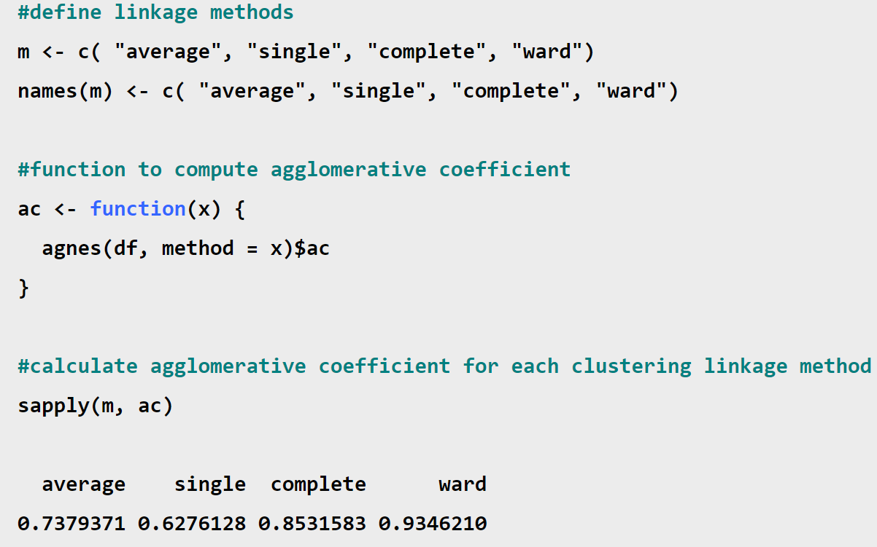
Hierarchical Clustering: Coding

Slide 9
Hierarchical Clustering: Advantages and Disadvantages
Advantages
Disadvantages
The Hierarchical Clustering method presents the following advantages:
Some of the disadvantages of this method are:
It is easy to understand and implement.
No need to pre-specify any particular number of clusters.
Can obtain any desired number of clusters by cutting the Dendrogram at the proper level.
They may correspond to meaningful classification.
Easy to decide the number of clusters by merely looking at the Dendrogram.
Does not work well on vast amounts of data.
When a decision is made to combine two clusters, it can not be undone.
Sensitivity to noise and outliers.
Faces difficulty when handling different sizes of clusters.
It is breaking large clusters.
In this technique, the order of the data has an impact on the final results.

